Slide 1

Deep learning, TEXT MINING, AND STOCK PRICE PREDICTION
Matthew Spitulnik
Notes:
Beau

Slide 2
Text Mining and Stock Price Increase Prediction
The question to answer: Can the text from news articles about stocks be used with deep learning models to predict whether a stock price will increase or decrease?
Method to answer: Compare the opening price of the stock the day the article is released (day 0) to the opening price of the stock the following market day (day 1).

Slide 3
The Data
Used sites like investopedia.com, seekingalpha.com, and marketwatch.com to compile list of ~500 trending stocks.
Built a function that used the trending stock list to attempt to collect news articles about each stock from investing.com.
The stock name/ticker and the date the article was released was then used along with the YahooFinance API (yfinance) to collect the day 0 and day 1 opening prices.
Ultimately, 8740 articles/prices could be located for 325 different stocks.

Slide 4
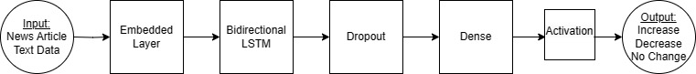
Base Deep Learning Model

Slide 5
Model Variations
66 different models were run with the following variations:
Input: raw vs. processed, max_len, num_words, test_size
Embedded: self vs. pretrained, mask, output_dim
LSTM: Number of units
CNN Layer (Conv1D) + MaxPooling1D?
2nd Dense Layer?
Various activation functions, compile optimizers, and compile loss options
Learning rates and regularizations
Validation splits and number of epochs

Slide 6
Raw Text Vs. Preprocessed
Raw Text:
# of words per article: ~408
Max # of words: 14424
Example article:
"Â\xa0 Investing.com - 23Andme Holding Co (NASDAQ: ME) reported third quarter EPS of $-0.16, $0.02 worse than the analyst estimate of $-0.14. Revenue for the quarter came in at $50M versus the consensus estimate of $56.8M. 23Andme Holding Co\'s stock price closed at $0.91. It is down -38.51% in the last 3 months and down -66.42% in the last 12 months. 23Andme Holding Co saw 0 positive EPS revisions and 1 negative EPS revisions in the last 90 days. See 23Andme Holding Co\'s stock priceâ€™s past reactions to earnings here. According to InvestingPro, 23Andme Holding Co\'s Financial Health score is "good performance". Check out 23Andme Holding Co\'s recent earnings performance, and 23Andme Holding Co\'s financials here. Stay up-to-date on all of the upcoming earnings reports by visiting Investing.com\'s earnings calendar"
Preprocessed:
Removed contractions, stock ticker/name, special characters, numbers, stop words, words less then 3 characters or greater then 13 characters.
Made everything lowercase.
Lemmatized the words, removed plurals.
# of words per article: ~193
Max # of words: 5529
Example article:
"invest hold nasdaq report quarter worse analyst estimate revenue quarter versu consensu estimate hold stock price close month month hold positive revision negative revision hold stock price past reaction earning accord investingpro hold financial health score good performance check hold recent earning performance hold financial stay up-to-date upcoming earning report visit invest earning calendar"

Slide 7
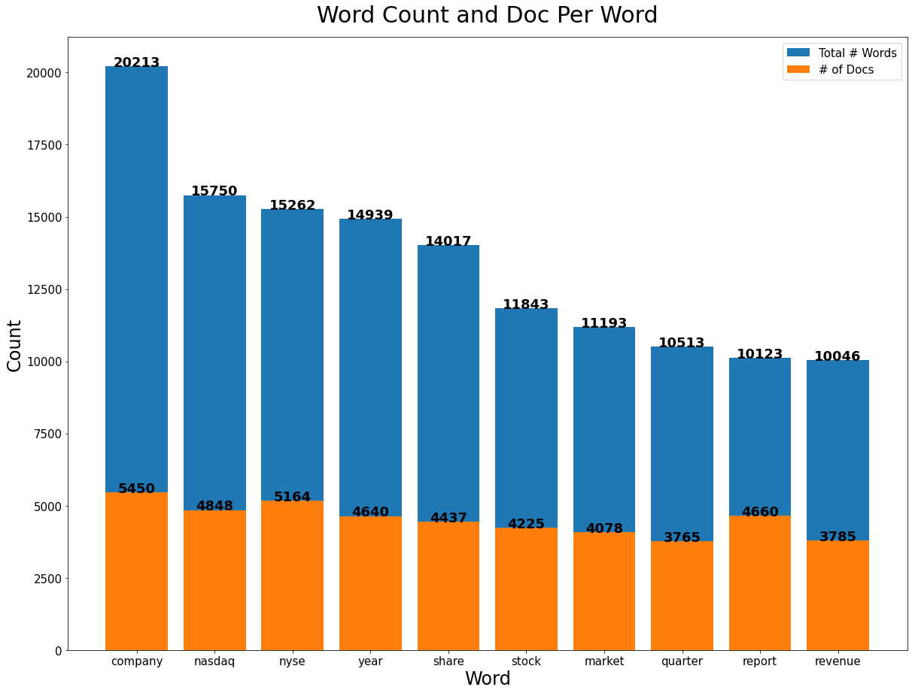
Word Counts Across All Documents (Preprocessed)

Slide 8
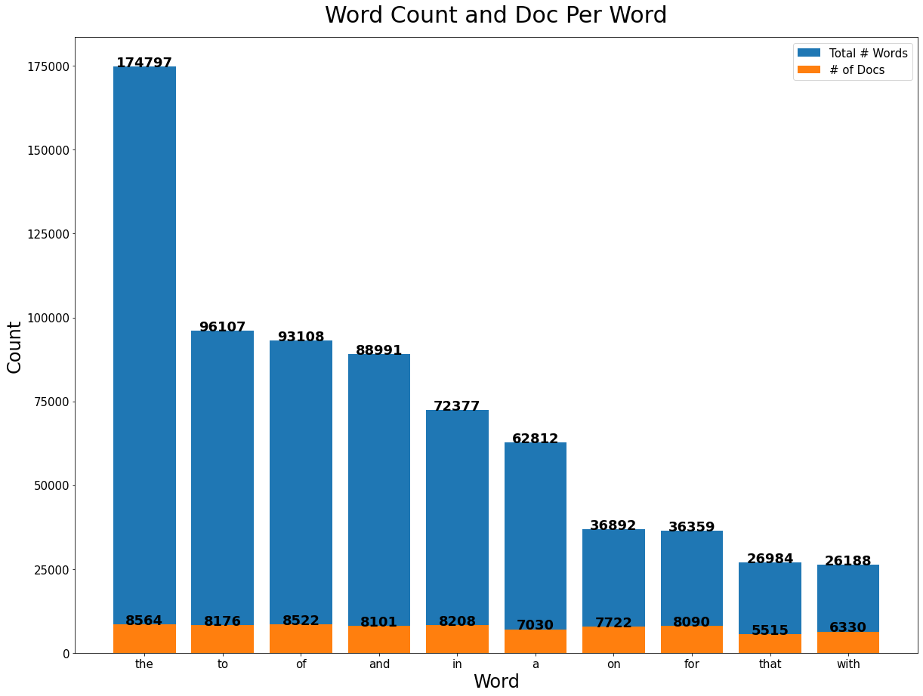
Word Counts Across All Documents (Raw Text)

Slide 9
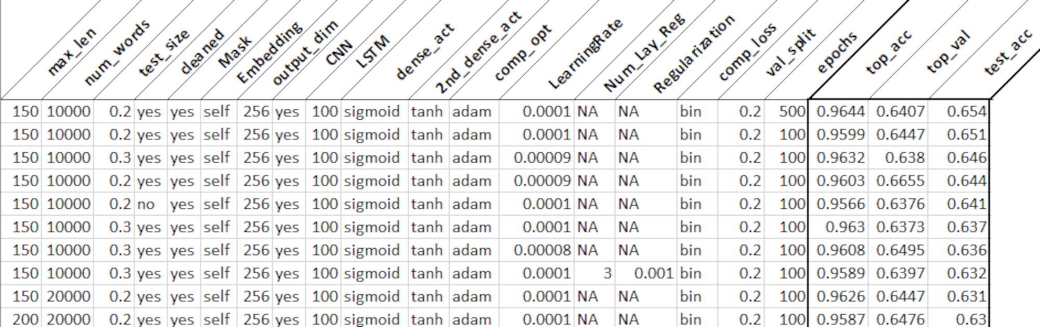
Top 10 Models Overall

Slide 10
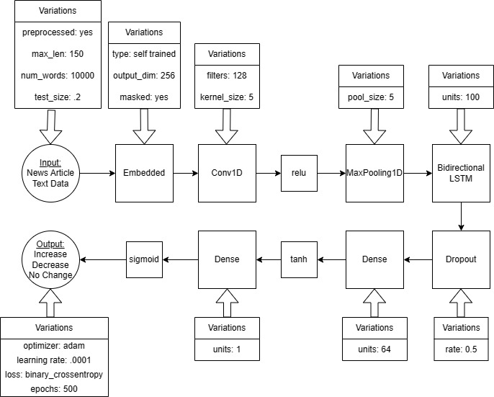
Best Model Architecture

Slide 11
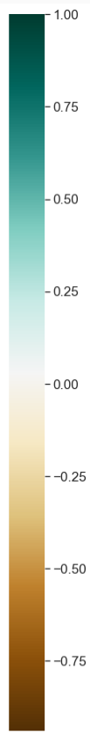
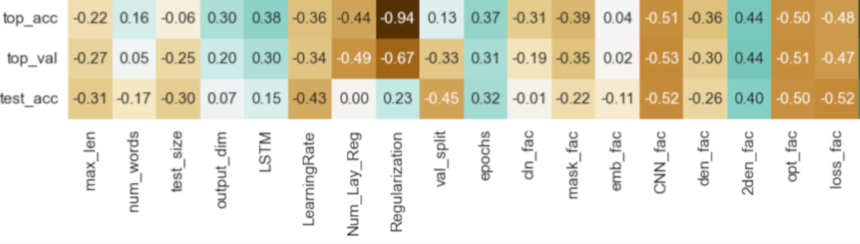
Variable Correlation

Slide 12
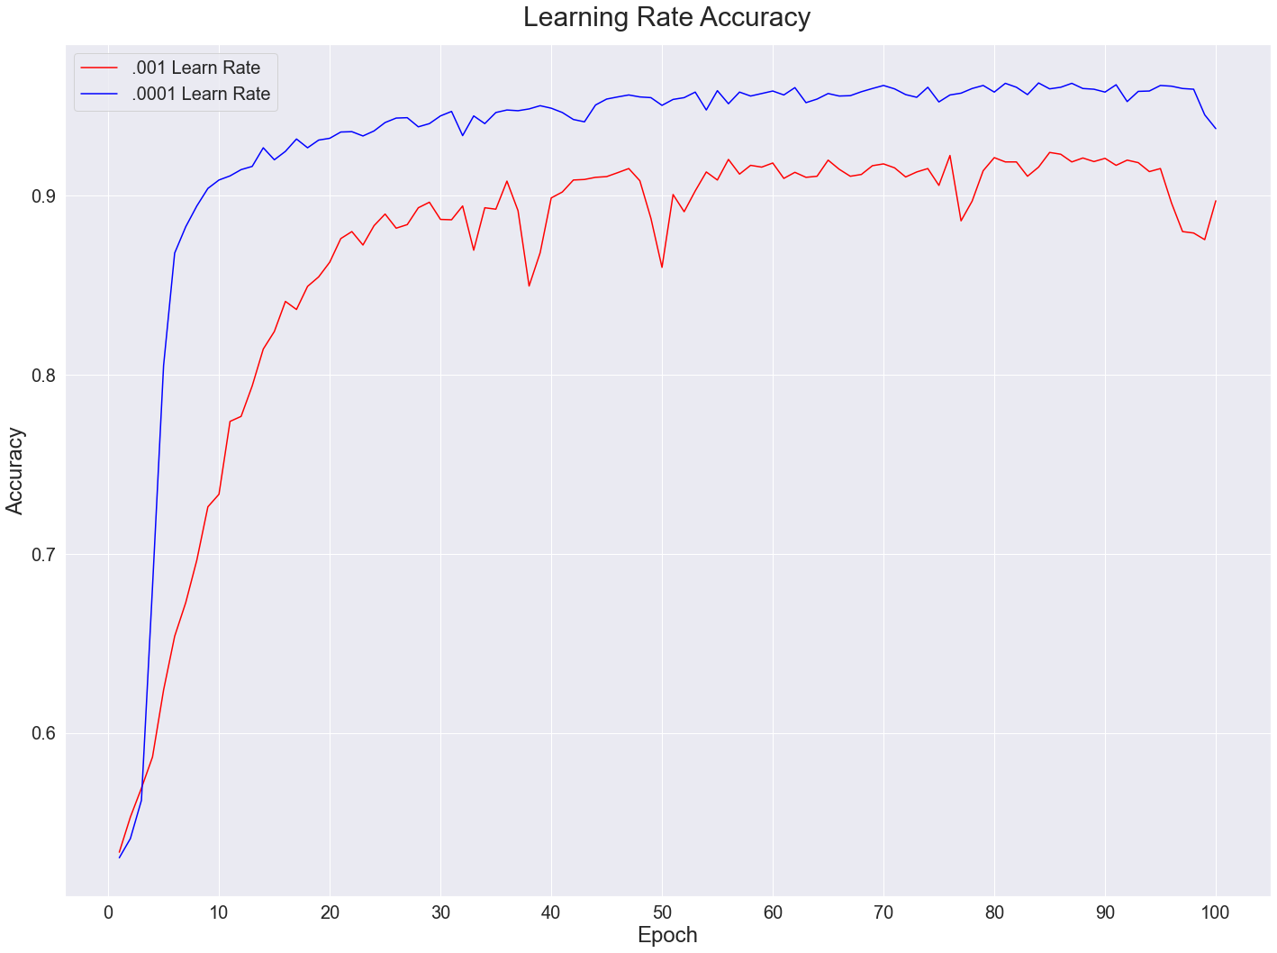
Learning Rate Effect on Accuracy

Slide 13
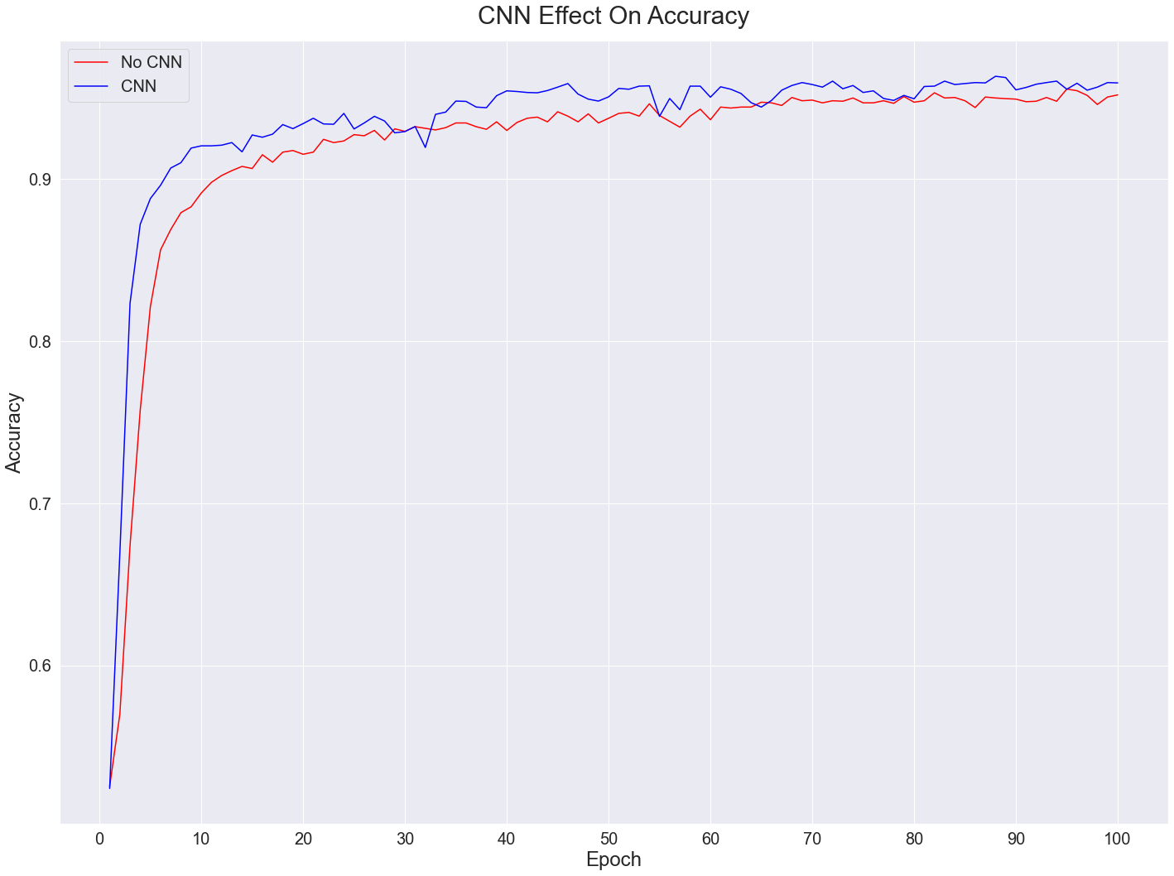
CNN Rate Effect on Accuracy

Slide 14
Text Mining Conclusions
Using a self-trained embedding layer increased accuracy but also run time.
Combining embedding, CNN, and RNN layers is beneficial.
Reducing the learning rate can assist in avoiding overfitting.
Cleaning the data helped with performance, but it may not be necessary for accuracy.
Allowing for too many words/sequences did not result in better accuracy (football field analogy)
Additional/more granular data most likely needed to achieve actionable results.
Look at exact time of day of article release (was it after closing, before closing, etc.)
Article released on Friday vs. other weekday, right before holidays, etc.

